Slide 1
SENKO-FLOW

Slide 2
Flow of SENKO(wafer stock~chip stock)
①Wafer Stock
⑤Bar Stack
⑨Chip Tester
②Banchi Cleaving
⑥Coating
⑩Chip output
SEM
③Banchi Anneal
※Specified 1 bar
⑦Bar Unstack
⑪Chip Stock
Select a designated Banchi
Select the specified number of bars
④Bar Cleaving
⑧Chip Cleaving

Slide 3
Flow of SENKO(After chip stock)
⑫LD D/B
⑰Aging
㉑Visual inspection
⑬Stem mounted
⑱DC Sorting-3
㉒Macro test
⑭W/B（Wire Bonding)
⑲Wire removal
⑮DC Sorting-１
⑳AC
⑯Purge

Slide 4
Flow of SENKO(After Macro test)
Macro test passed
㉗IV Curve 100V
㉓W/B remove
㉘ESD test ±300V
㉔W/B
㉙ IV Curve 300V
㉕IV Curve 0V
㉚ESD Macro
※There are separate test items for the direct change process.
㉖ESD test ±100V
Finish

Slide 5
Advance evaluation of major varieties Construction start banchi and number of construction starts
Variety | Use banchi number | Number of bars | Number of chips required for assembly
B5(3inch) | Ah,Bf,Cf,Da,Dh | 3 bars each | 10 Chips each(total50 chips)
B8 | Ah,Bf,Cf,Da,Dh | 3 bars each | 10 Chips each(total50 chips)
B5(4inch) | Ag,As,Bc,Bj,Cj,Ck,Da,Ds | 3 bars each | Da=8 chips others are 6 chips each(total50 chips)
E1 | Ah,Bf,Cf,Da,Dh | 3 bars each | 10 Chips each(total50 chips)
A6(4inch) | Aa,Ad,Af,Bf,Cf,Da,Dd,Df | 3 bars each | Aa=7 chips,Da=7 chips others are 6 chips each(total50 chips)
Currently, all bars are mounted on one ring

Slide 6
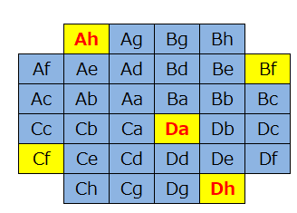
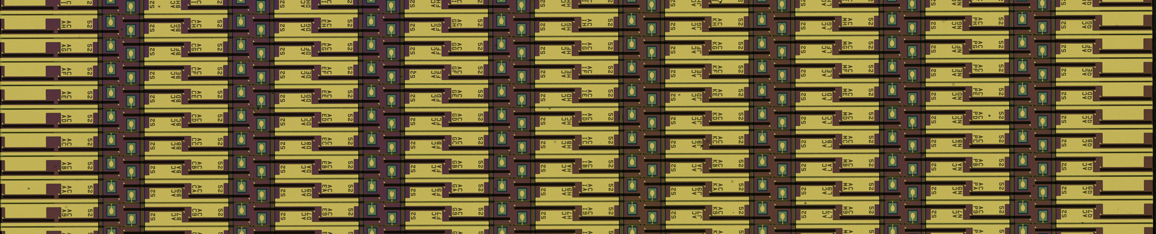
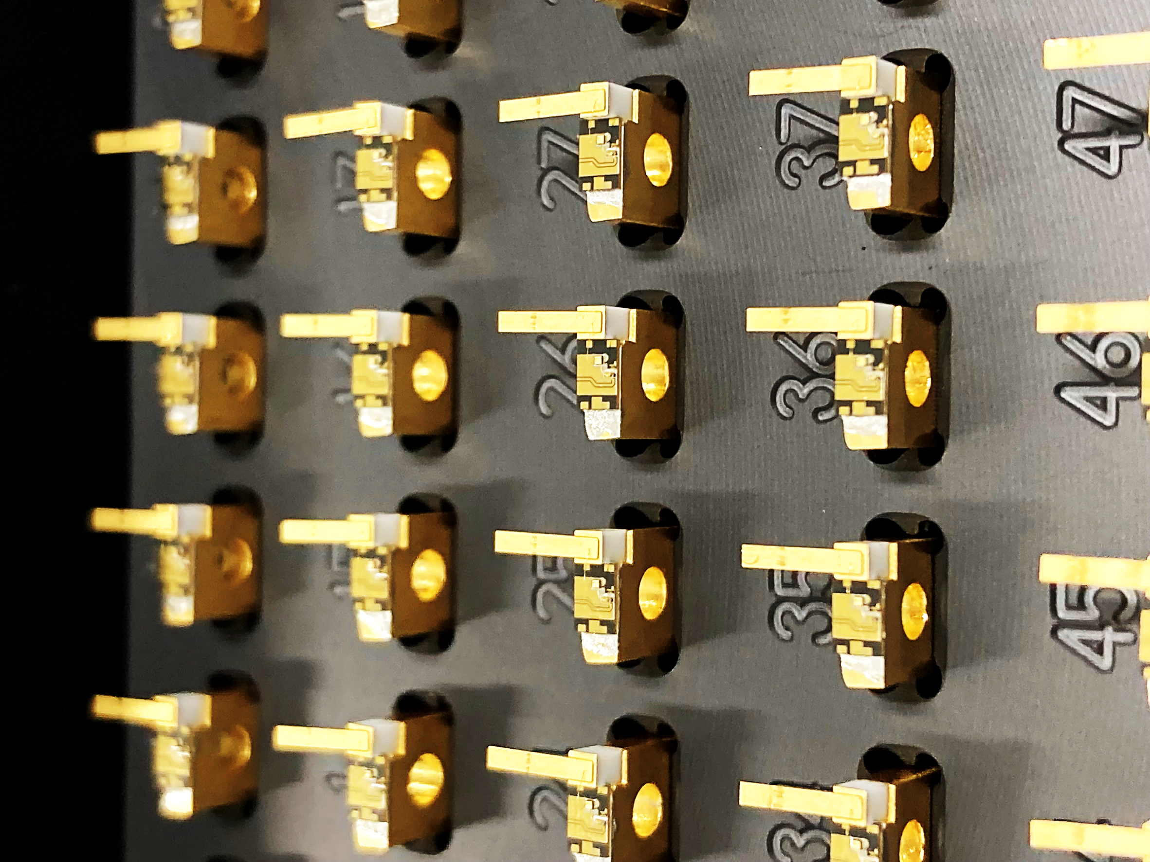
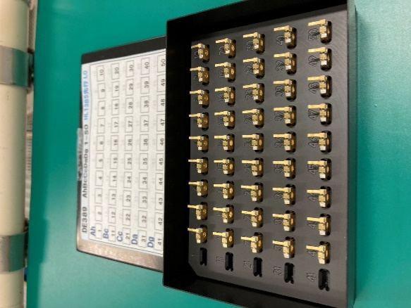
B5(3inch)&E1
a b c d e f g h I j k l n m p q
Tested products
a
q
h
h
or
q
a
50 pcs
All bars may be installed
Each banchi requires a good product of 20chip or more.

Slide 7
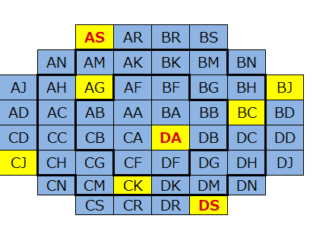
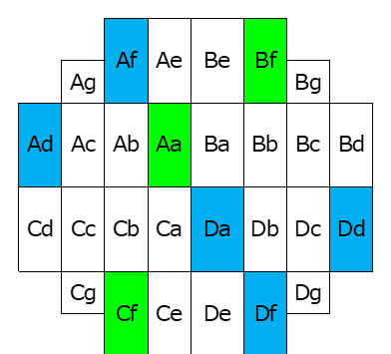
A6(4inch)
B5(4inch)

Slide 8
Thank you

